Slide 1
Drafting Behind Akamai_x0003_
(Travelocity-Based Detouring)
AoJan Su, David R. Choffnes, Aleksandar Kuzmanovic, and Fabian E. Bustamante
Department of Electrical Engineering and Computer Science
Northwestern University
Presented by Anand Mehta

Slide 2
problem
we wish to route data over the internet
the key to routing well is to select a good path
to select a good path, you need to perform measurements on different routes
these measurements take up resources and they need to be done frequently

Slide 3
observation
internet path measurements are being done constantly by content distribution networks (CDNs)
the CDNs’ goal is to find the best path to each end user
what if we can exploit the CDN's measurements for our own routing?
Notes:
Check If ppl know what a cdn is.
in other words, why do our own measurements, if someone else is already doing it?

Slide 4
experiments
are CDNs actually doing measurements regularly?
do client redirections generated by the CDN Akamai actually use paths with good network conditions?
if so, can we utilize this information for some useful purpose?
  a potential application utilizing this information is tested
Notes:
If the akamai paths are very good, we can see what paths they use, this gives us useful information
Now can we use this for some useful app?

Slide 5
content distribution networks
CDNs are contracted by web entities to distribute content to end users in place of them
CDNs are typically faster at distributing content - pictures, videos etc. to end users
how are they faster?
  they set up multiple, geographically dispersed servers at the edge of the network
  they also perform network measurements routinely
  thus they find the best replicas and fastest paths over which to transfer content to the end user

Slide 6
how does Akamai work?
imagine a web page (eg. Yahoo) with its images on Akamai’s CDN
a web client first uses DNS to find the node hosting the image
this (Yahoo) DNS server redirects the client to Akamai’s authoritative DNS name server
this will resolve the IP addresses of relevant content servers near the web client
it will redirect the web client appropriately
Notes:
Akamai is the world’s largest CDN

Slide 7
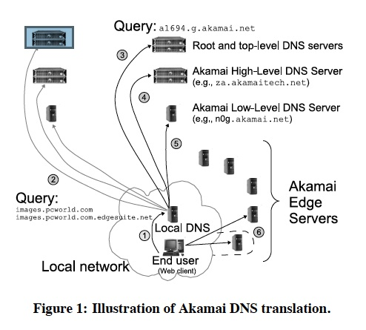
DNS translation
Notes:
what about caching?
- this could be bad, coz if you want to get the fastest path to you at that time, stale information from cache is not good
thus akamai sets the cache timeout for all the dns to a very small value, 20 seconds

Slide 8
part I: measuring Akamai
the Akamai network is studied to find out important system parameters
metrics include:
  server diversity over long time intervals
  the impact of end user’s locations on server diversity
  the impact of client (Yahoo, Amazon, etc.) on server diversity
  DNS servers’ entries’ update frequency
Notes:
important system parameters are the scale and dynamics of Akamai driven redirections
Define server diversity as the amount of distinct akamai edge servers that are seen by a particular end user over a period
Dns servers’ entries’ update frequency tell you how quickly akamai updates its dns servers to best current paths

Slide 9
methodology
used 140 PlanetLab nodes scattered around the world
every 20 seconds, each node sent a DNS request for one of the Akamai customers
the node recorded the IP addresses of the edge servers returned by Akamai
15 Akamai customers were measured including Yahoo, Amazon, AOL, NYT
experiment was run continuously for 7 days
Notes:
Akamai returns 2 edge servers not one

Slide 10
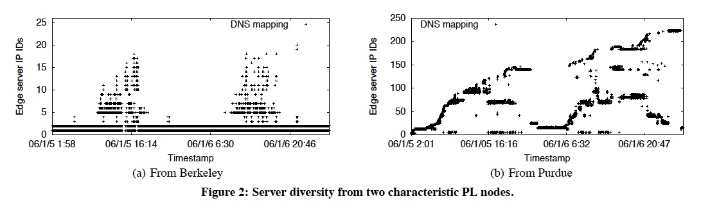
server diversity measurements
Notes:
The paper declares that the akamai edge servers are closer to you will lead to low server diversity.
This experiment is to find out how many servers edge points see over a long time scale (2 days).
graphs show the no of ips seen by the client (yaxis) with time (xaxis)
you can see that time of day has strong effects on the servers seen, and is more pronounced when the PL node is close to the akamai node
but the point is that, the results show that berkeley sees a lot fewer nodes than purdue.
this is because the akamai edge servers are very near berkeley, and far from purdue.
so berkeley always sees these near nodes.
however purdue sees different nodes based on n/w traffic.

Slide 11
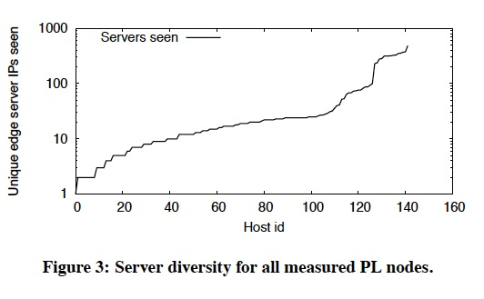
server diversity measurements
Notes:
Each host is plotted against no of seen Ips (in ascending order)
- this experiment was repeated for all PL nodes, and it was seen that there was a wide variation in the number of nodes seen by PL nodes, ranging from 2 to 340.
- the conclusion is that the larger the network distance between a node and its Akamai servers, the larger the number of edge servers and corresponding network paths

Slide 12
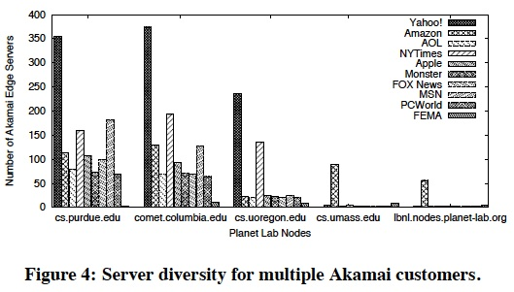
impact of different customers on server diversity
Notes:
- shows amount of servers seen for each akamai customer, sorted by PL nodes
- experiment: 5 nodes, 10 customers
- different customers hosted on different nodes, to alleviate load on the nodes
- all PL nodes show a large server diversity for at least one of the Akamai customers
- since Akamai customers are hosted on different sets of servers, all clients, no matter how close they are to an Akamai edge server, can see a large number of servers

Slide 13
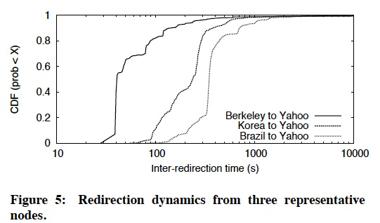
redirection dynamics
Notes:
- want to verify that the updates are happening at sufficiently short time scales to capture changes in network conditions
- we measure the frequency with which low level Akamai DNS servers actually change their entries, by comparing responses from the DNS servers
- 50% of the redirections are shorter than 40 seconds, while more than 80% of the redirections are shorter than 100 seconds
- question: if n/w performance remains constant, the redirections won't change for a long time, so redirections will show up longer; this is not taken into account here

Slide 14
part II: does Akamai reveal quality internet paths?
Akamai chooses the best server based on latency to client
latency can be both in the network and on the server
do Akamai redirections correlate with network conditions over the paths to clients?
if Akamai chooses based on the network latency, then Akamai’s decisions give us useful information
Notes:
akamai tries to tell you the best server, based on latency
But is there a more latency in the network is it mainly server side
Measurements are done to find out, pinging used to isolate n/w latency
If there is a strong correlation between n/w latency and akamai’s redirections, it means that akamai chooses servers based on that
If so Akamai’s decisions give us useful information about prevailing network latency

Slide 15
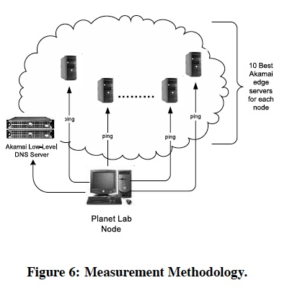
methodology
ran experiment for 7 days
for each of the 140 nodes:
find the 10 best (lowest latency) paths to Akamai servers
ping Akamai every 20 seconds and see if it returns paths close to the best possible
Notes:
To find 10 best paths just see which ones seen so far have lowest latency (network latency)
These are best paths
Best = lowest latency
PING to isolate network latency

Slide 16
rank
rank the 10 best paths from 0 (the longest) to 9 (the shortest)
Akamai returns IP addresses of two edge servers in each round, r1 and r2
total rank = r1 + r2 − 1
best two paths returned: rank = 16
worst two paths: rank = 0
a good rank indicates a well chosen path wrt network conditions
Notes:
Gave ranks to each ip pair returned by akamai
Compared with the best path (16) for different nodes

Slide 17
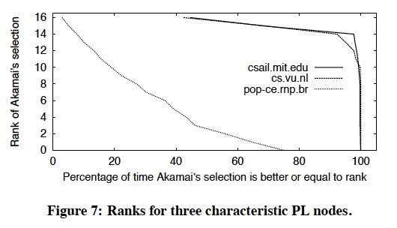
rank measurements
Notes:
- from 3 PL nodes, measures for yahoo
shows that at 2 of the sites measured, akamai dns returns really good ranked paths
Always better than rank 14 for mit and vu
- however the brazil node is really bad, even worse than random selection between the 10
- this is due to the fact that the paths are updated infrequently in S. America.

Slide 18
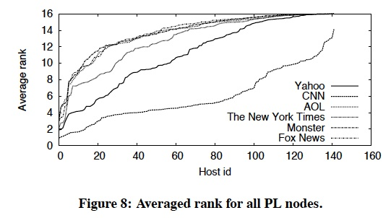
rank measurements
Notes:
- this shows average rank of the paths that Akamai returns to all 140 PL nodes for different customers
- the order of PL node IDs on the x-axis, while similar, is not identical for different customers
- more than 70% of Akamai paths are approximately among the best 10% of paths
thus we can see that Akamai redirections are based on network conditions
fig shows CNN having bad ranks, this is because its actually not a akamai customer

Slide 19
latency
the latency gains are measured, to observe the performance of Akamai
terminology:
  best delay
  Akamai’s delay
  average delay
  worst delay
Notes:
best delay is the lowest RTT in each 20-second-long measurement among the ten best Akamai paths.
akamai’s delay is the average RTTs of the paths to the two edge servers selected by akamai
average delay is the average of the ten best akamai recommended paths.
worst delay is the highest RTT in each measurement round among all ten paths.

Slide 20
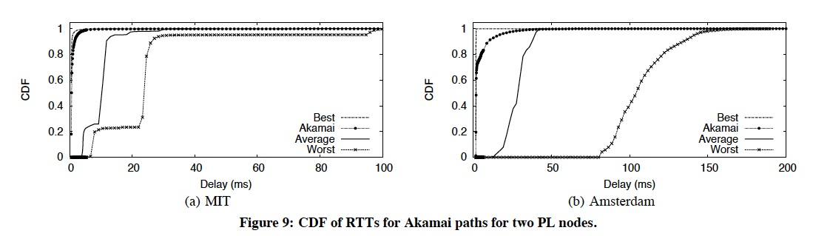
latency measurements
Notes:
- MIT gets really nodes really close to best latency, so does amsterdam
- difference is that amsterdam average and worst delay is much bigger (100ms!)

Slide 21
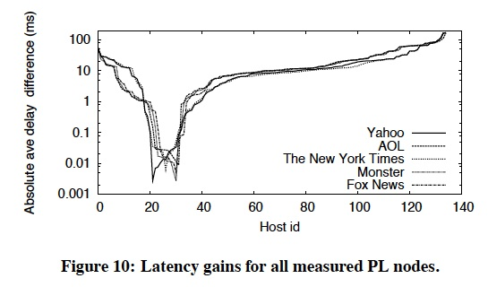
latency measurements
Conclusion: Akamai redirections are based on the network latency and hence reveal network conditions over the paths between end-users and Akamai edge-servers
Notes:
- shows latency performance over all 140 PL nodes for different Akamai customers
- compute the average difference between average delay and the Akamai path.
- nodes on the left of the figure (e.g., 0-20) show the worst performance
- these are nodes that have a large server / path diversity and a small redirection frequency
- in the middle are a small number of short-latency Akamai paths
- the vast majority of nodes are directed to better-than-average paths
- this proves that redirections overwhelmingly reveal the network conditions over the paths between end-users and Akamai edge-servers

Slide 22
part III: Akamai driven one hop source routing
Akamai can tell you high quality paths, and this information is useful for many applications
the potential for performance improvement to an example application is examined
the application is a one-hop routing in a large-scale overlay network
a routing path is chosen based on the lower latency, among the direct path, or the one-hop path via an Akamai server
Notes:
Studied the potential for an application to use the information provided by akamai

Slide 23
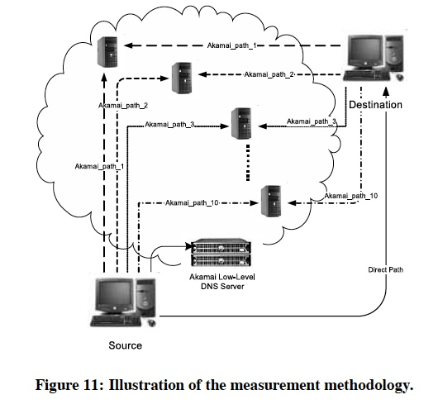
methodology
source tells destination the 10 best paths to Akamai servers from it
destination finds the sums of total time from source to Akamai server to itself
also keeps track of time taken for direct path
this measurement is asymmetric
Notes:
- for each pair of nodes, one node is the source and the other as the destination
- we measure the RTTs for 11 paths between the source and the destination.
- the first path is the direct one, which the source node measures by pinging the destination and recording the corresponding RTT.
- the other ten paths are the best ones 'recommended' by Akamai
- the source node notifies the destination node of the IP addresses for these 10 akamai
edge servers
- the destination node adds these with its own delays to these edge servers and the total gives the total latency for the one hop route

Slide 24
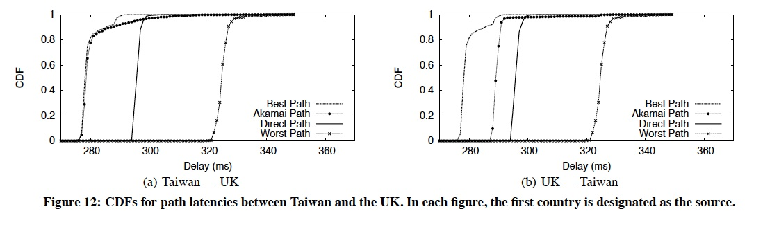
Taiwan - UK one hop routing
Notes:
- akamai paths perform very well
- for the Taiwan node, 80% of edge server hits are in Tawain, 5% in the US
- for the UK’s node, 75% of the hits are in the UK, and 25% are in the US
- these results indicate that the gains over the direct path come from avoiding hot
spots close to the sources.

Slide 25
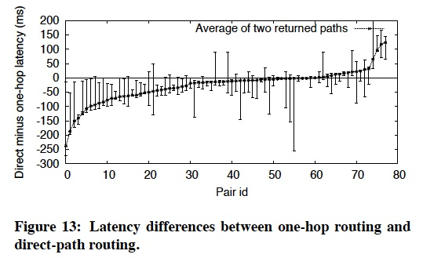
one hop vs direct routing
Results for one hop routing between 91 pairs of randomly chosen nodes
Notes:
91 pairs of nodes are randomly chosen and one hop routing is done
Comparing direct path to one hop path
- a negative value means that the corresponding direct path is better for the pair
- otherwise the Akamai-driven path is better
- in approximately 25% of scenarios, Akamai-driven paths outperform the direct path
- case I: the majority of the paths are intercontinental, excluding South America e.g., Asia-US, US- Europe. right side of graph
- case II: intra-US or intra-Europe pairs don't have much potential for latency gains. middle of graph
- case III: PL nodes that are close to each other and relatively far away from Akamai servers that have a better direct path. left of graph

Slide 26
path pruning
as we saw, routing one hop through Akamai is not always the best routing decision
thus an algorithm was developed to choose which path to use, one hop or direct, minimizing the number of network measurements required to find that path
experiments performed to find best tradeoff between network performance and measurement overhead

Slide 27
metrics
four schemes tried based on a combination of two metrics:
how frequently should the algorithm reevaluate the decision to use the direct path or one-hop paths:
    once for the duration of the experiment (static)
    reevaluate every y minutes (dynamic)
should the algorithm choose between servers returned by Akamai for one hop routes:
    don’t choose, use the first returned server (FAS)
    use the better of the two servers (BTAS)

Slide 28
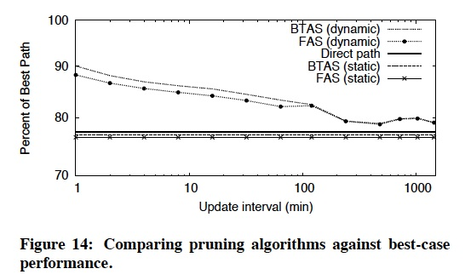
results
Notes:
One hop source routing using pruning can give benefits
Experiment not explained very well, done with the same set of pairs of PL nodes
Direct path gives best path 80% of the time
Dynamic schemes give even better performance, changes depending on how often you perform measurements
Upto an update interval of 100 mins performs well

Slide 29
my thoughts
utilizing measurements done by external parties for own purposes is very smart
why was server diversity measured?
could have done better with pruning algorithms
some assumptions not fully justified
  when they say best 10 paths, they actually means the best 10 noticed paths
  when measuring server diversity, two days is taken as ‘a long time’. is that long enough? network conditions can change significantly over days and weeks
Notes:
in redirection dynamics, if n/w performance remains constant, the dns entries won't change for a long time, so entries will show up longer, so graph will show that servers aren't updated fast enough
this is not taken into account when doing redirection dynamics measurements
they declares that the akamai edge servers are closer to you will lead to low server diversity. do i agree?
sounds reasonable, but need concrete proof, can’t just declare that

Slide 30
thank you!
questions?

Slide 31
discussion
Akamai applies one-hop source routing to transfer content from customer origin servers amongst its own networks
‘free riding’ on Akamai:
Akamai might not like third parties exploiting the CDNs’ measurements for their own purposes

